Slide 1



FRYDEK-MISTEK, Kvapilova 2133, 738 01
CZECH REPUBLIC
www.transcon.cz

Slide 2

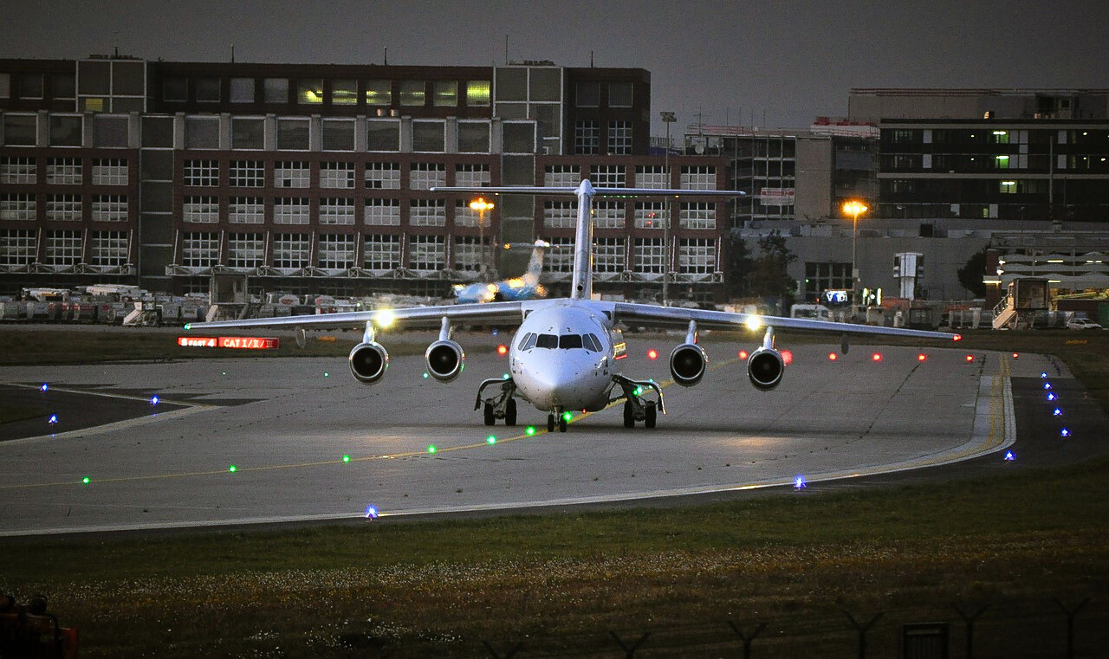
Introduction
Founded in 1990 in the Czech Republic, we specialize in the development, production, and servicing of turnkey solutions for:
  Airport and heliport lighting systems
  Airport and heliport control and monitoring systems
  Mobile and stationary airports and heliports
  Modular solutions for regional airports
With successful projects in over 300 civil and military airports and heliports across Europe, Africa, Asia and America, our expertise is recognized worldwide.
Our products comply with ICAO, FAA, STANAG, FAVT, and MAK standards and meet the highest international certifications, including ISO 9001:2009, ISO 14001:2005, ISO 27001:2023, and OHSAS 18001:2008.

Slide 3
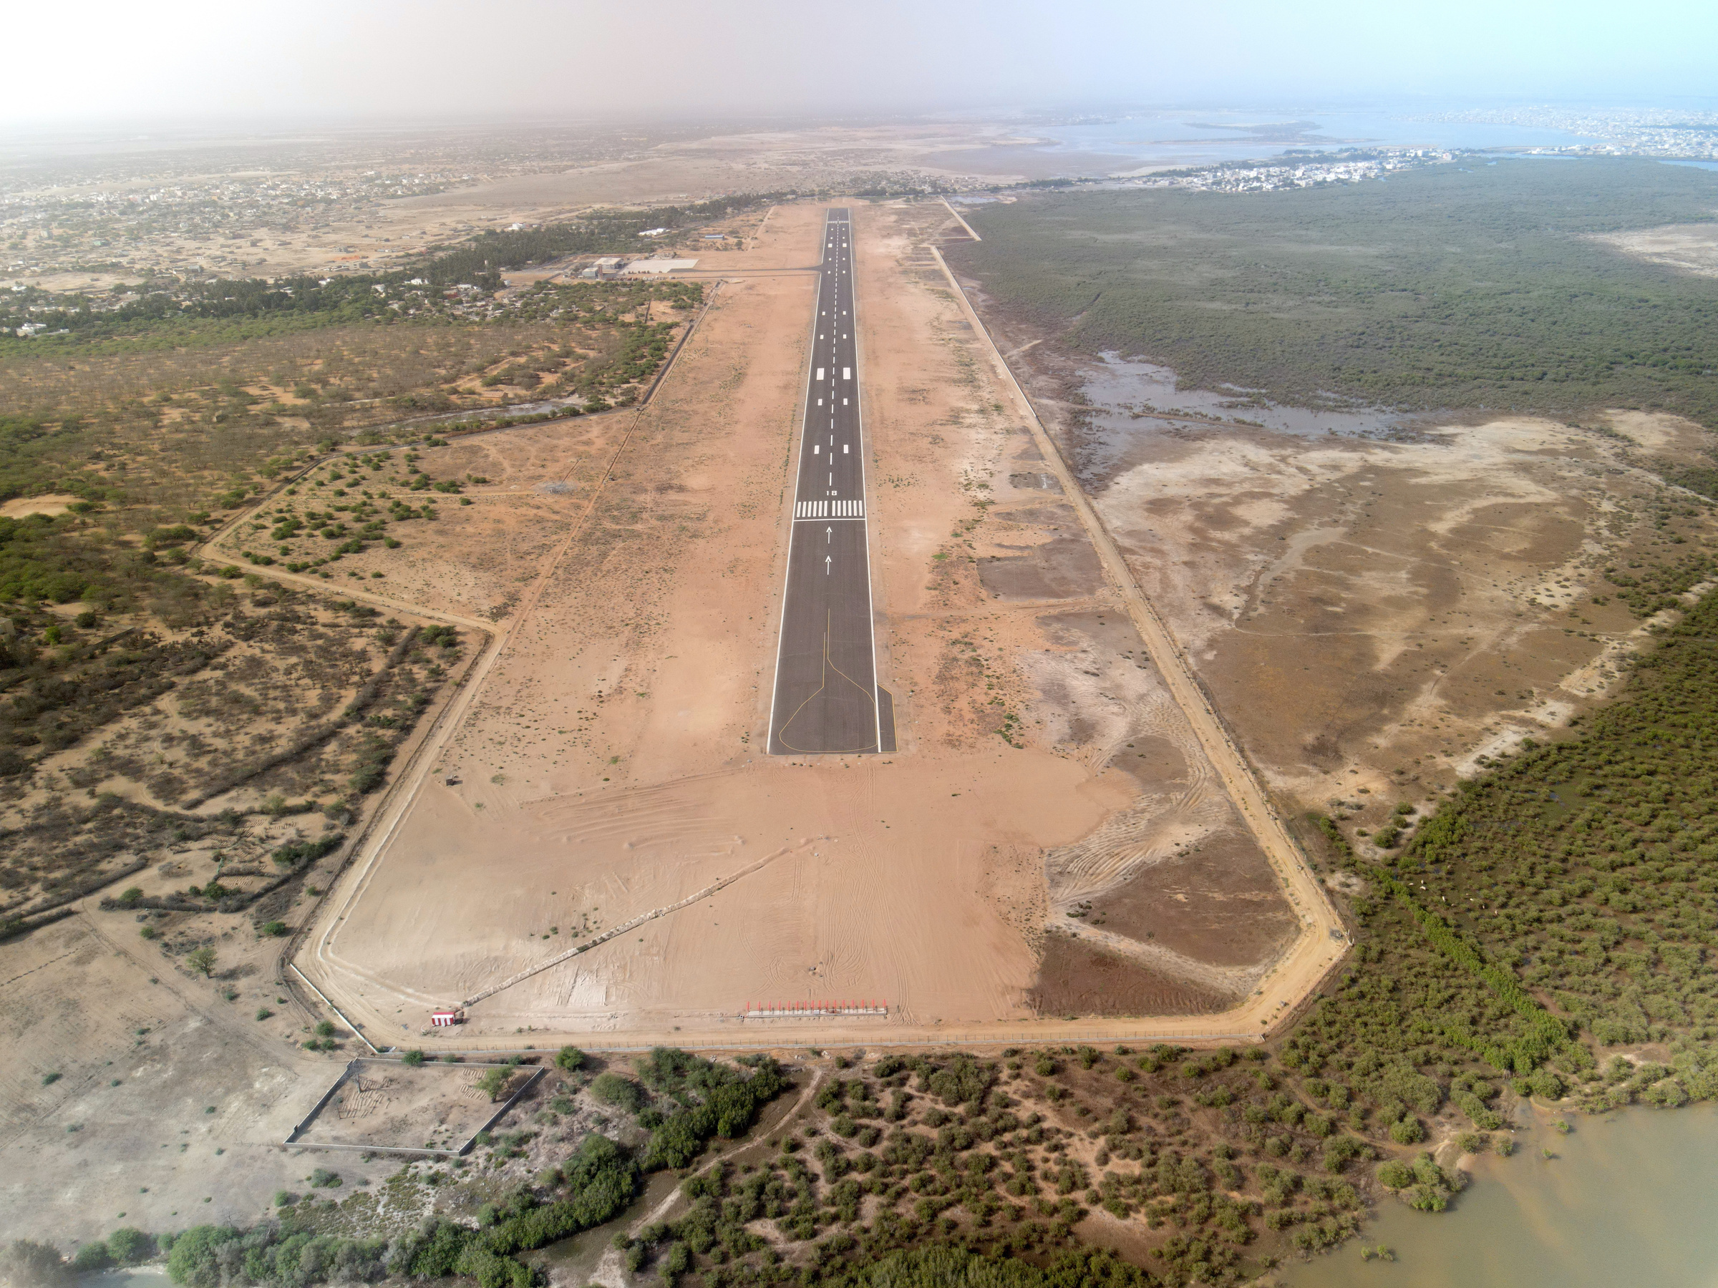

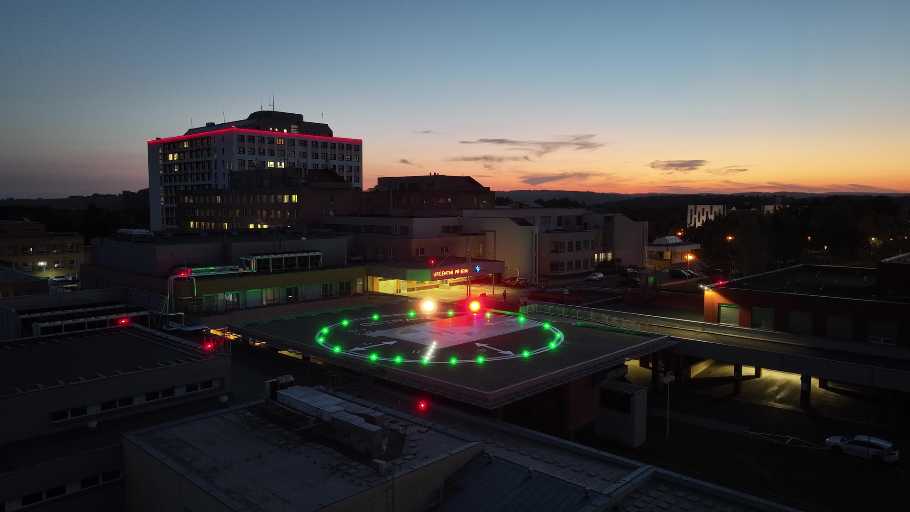

Our projects
Our key projects include the reconstruction of five regional airports in Senegal (PRAS program), the development of the MoLiS mobile lighting system with VUT, and the modernization of two regional airports in Mongolia, showcasing our global expertise in airport technologies.

Slide 4
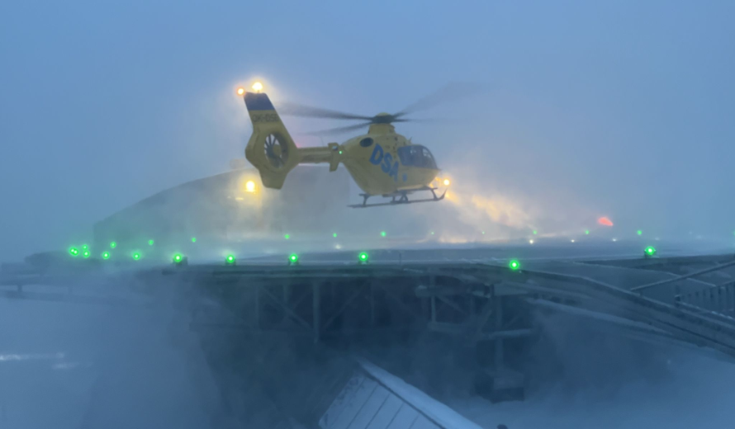
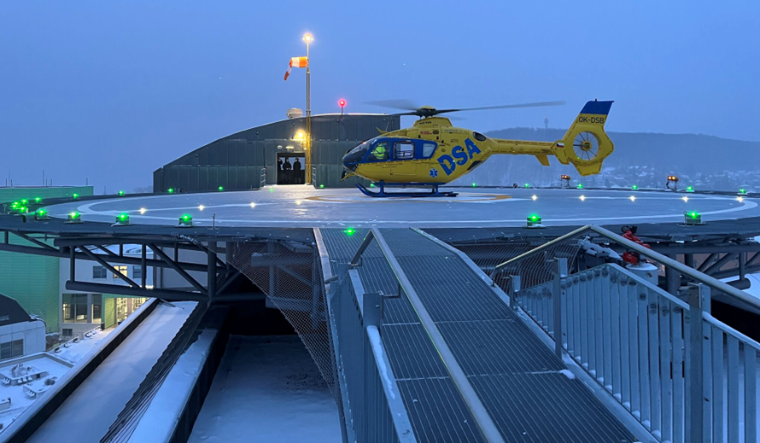

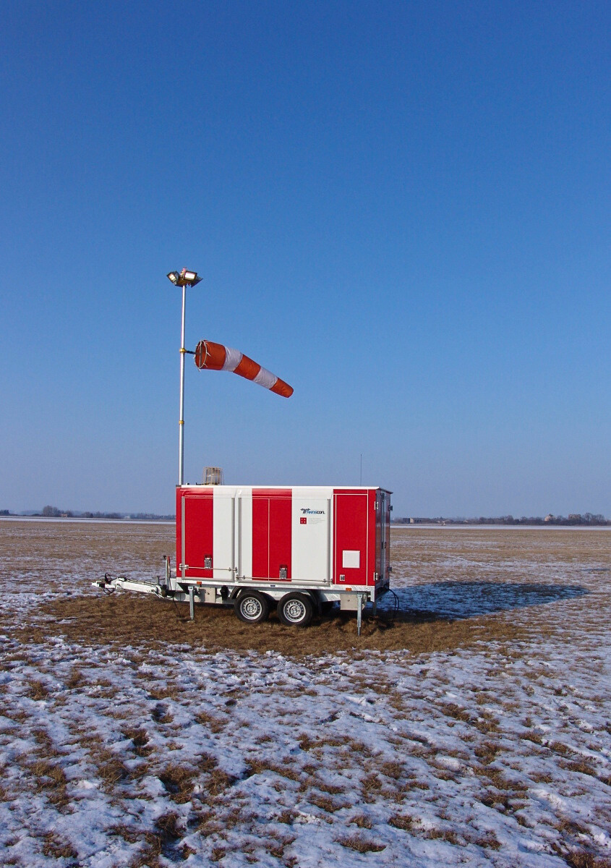
Our projects
Our key projects include the reconstruction of five regional airports in Senegal (PRAS program), the development of the MoLiS mobile lighting system with VUT, and the modernization of two regional airports in Mongolia, showcasing our global expertise in airport technologies.

Slide 5
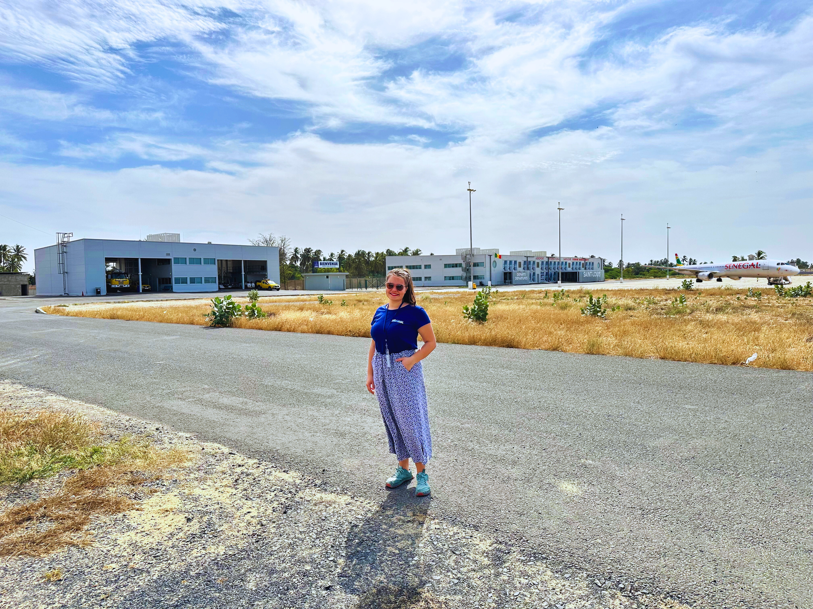

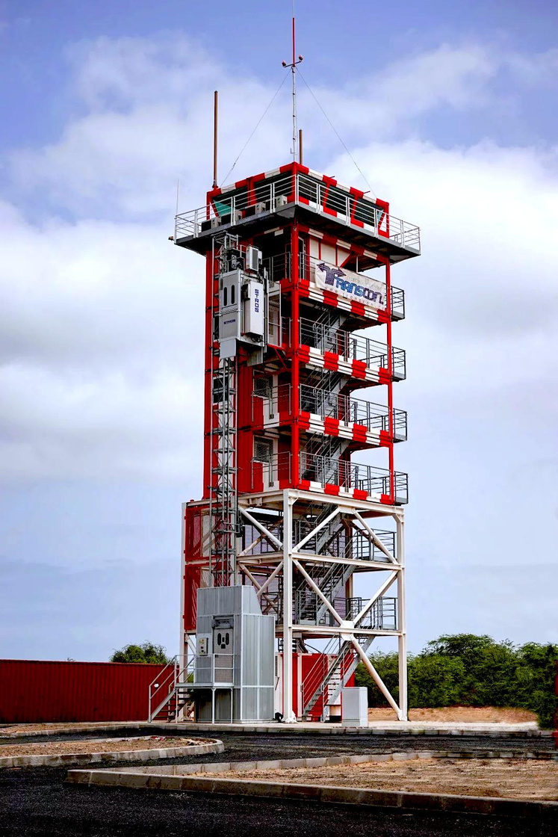
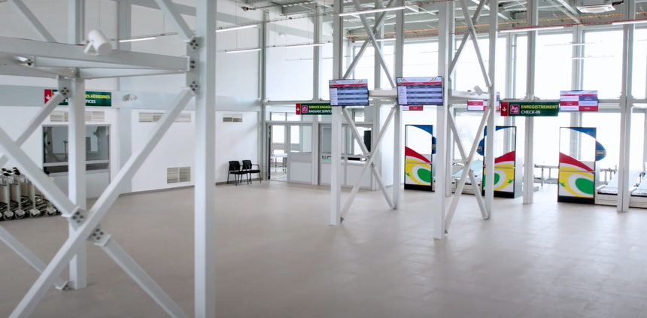
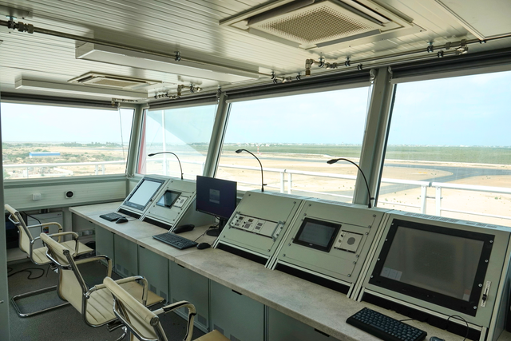
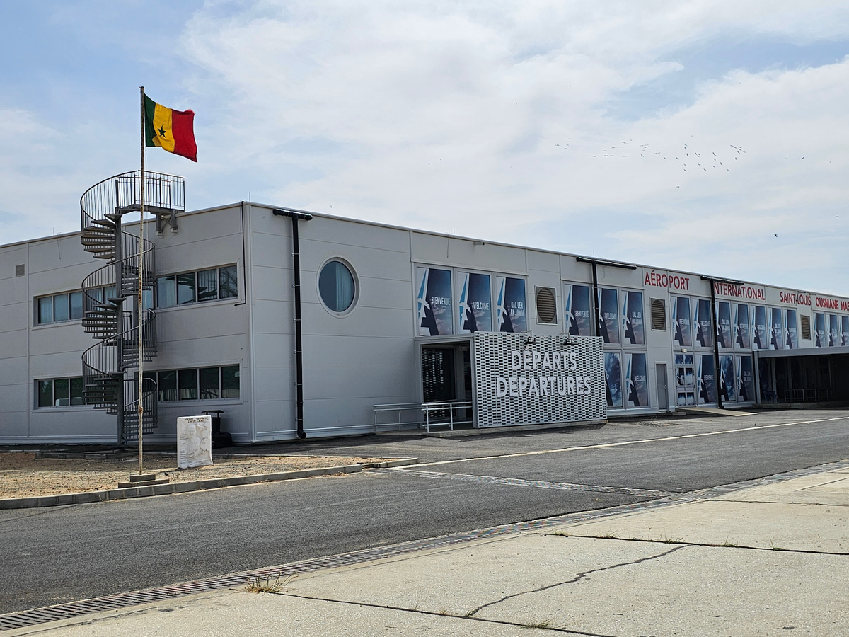
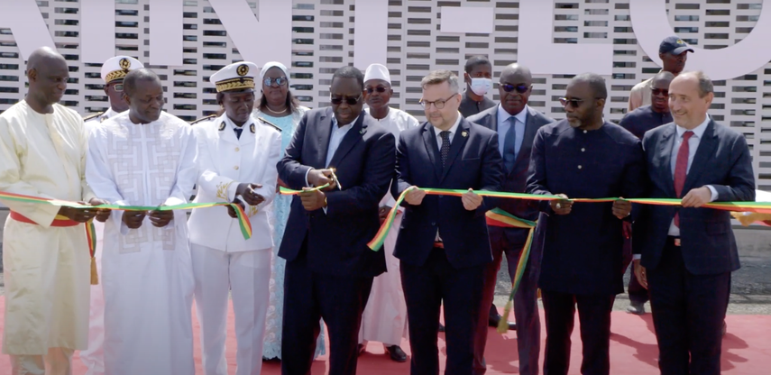
COMPLEX MODULAR AIRPORT IN SENEGAL

Slide 6
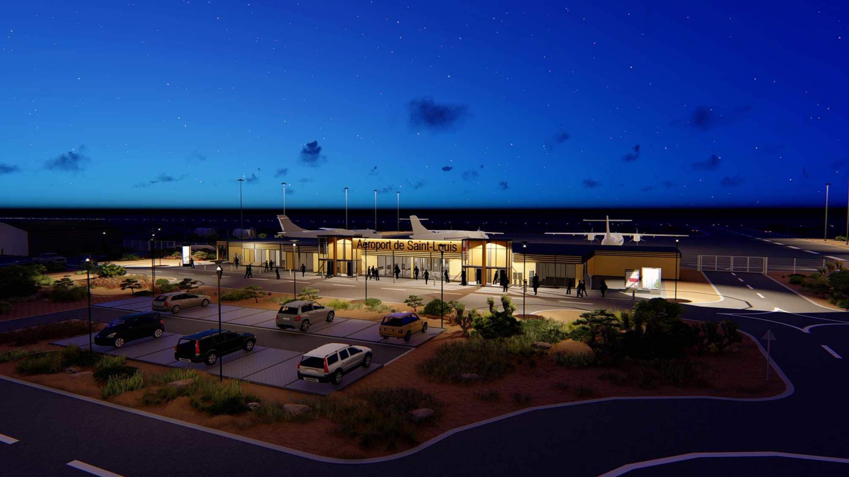

Turnkey & design build
TRANSCON is world’s only company which successfully managed to design, manufacture and install comprehensive modular solutions for regional airports of virtually any type, category and size.
Main segments and technologies:
  modular ATC towers
  modular passenger terminals (departure/arrival)
  modular hangars for airport handling and service equipment
  modular fire-fighting and ambulance stations
  modular redundant power supply systems

Slide 7
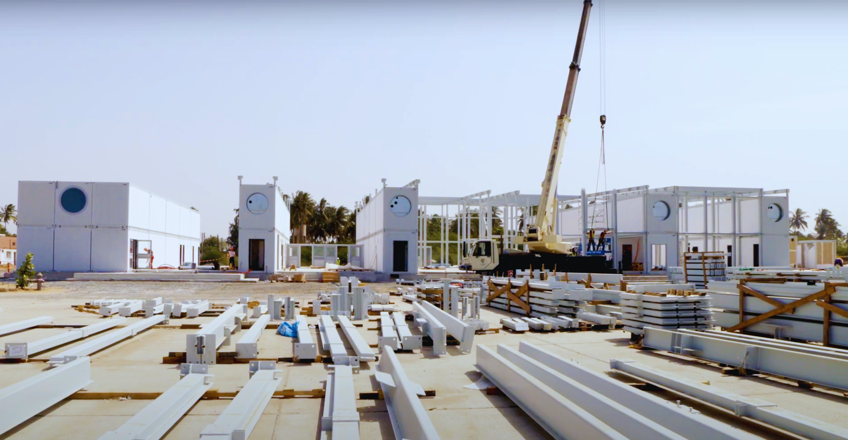
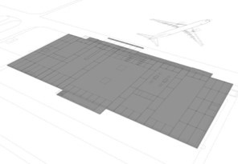
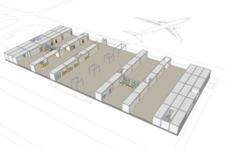
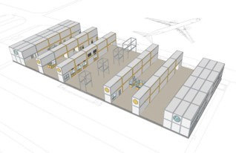
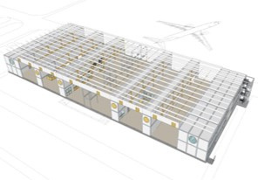
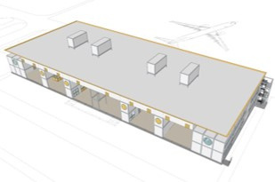
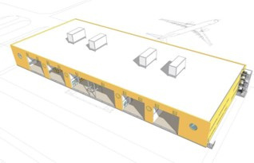
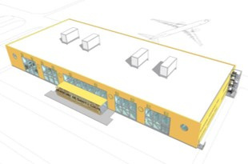
Modular systems
  COMPLETE SOLUTIONS: terminal, control tower, hangars, radio navigation and airfield lighting (runway and surfaces)
  QUICK TO IMPLEMENT: approx. 12 months due to the use of prefabricated modular structures
  REASONABLE PRICE AND PROFITABILITY LIFETIME: 20+ years
  ADVANCED, UP-TO-DATE TECHNOLOGIES: founder and sole manufacturer of modular airport technologies
  TRAINING OF HIGHLY QUALIFIED LOCAL EXPERTS: possible technology transfer

Slide 8
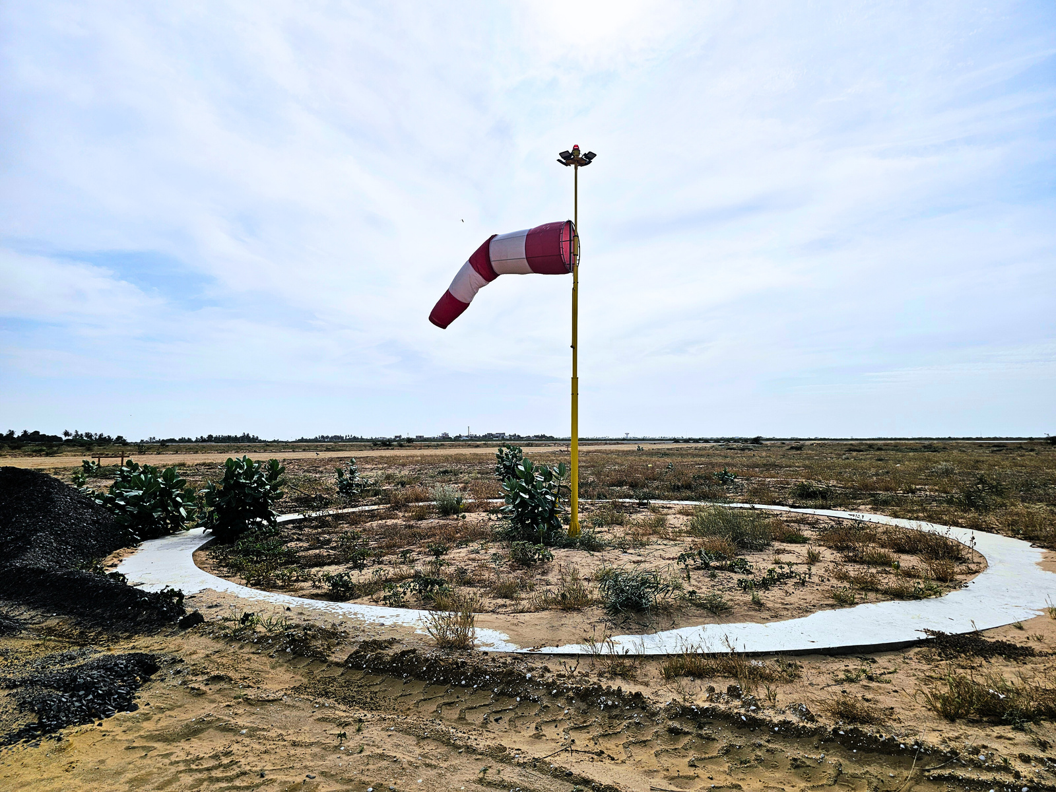

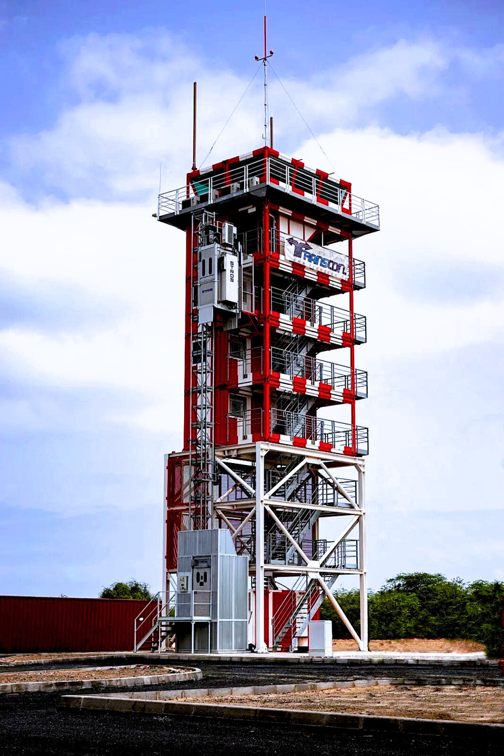
Product line
  Airfield Ground Lighting Systems - Runway, taxiway, apron, obstruction lights, floodlights, flash beacons, airport signs and essential accessories like cables, transformers, and connectors. ​
  Control and Monitoring Systems - Advanced electronic dispatching, monitoring, and control systems designed to enhance airport operational efficiency and safety.
  Modular Airport Solutions - Customized mobile and stationary airports and heliports housed in standard container modules, offering flexible and rapid deployment options.
  Power Supply Systems - Reliable power solutions, including standby power sources such as diesel generator sets and uninterruptible power supplies (UPS), ensuring uninterrupted airport operations. ​

Slide 9
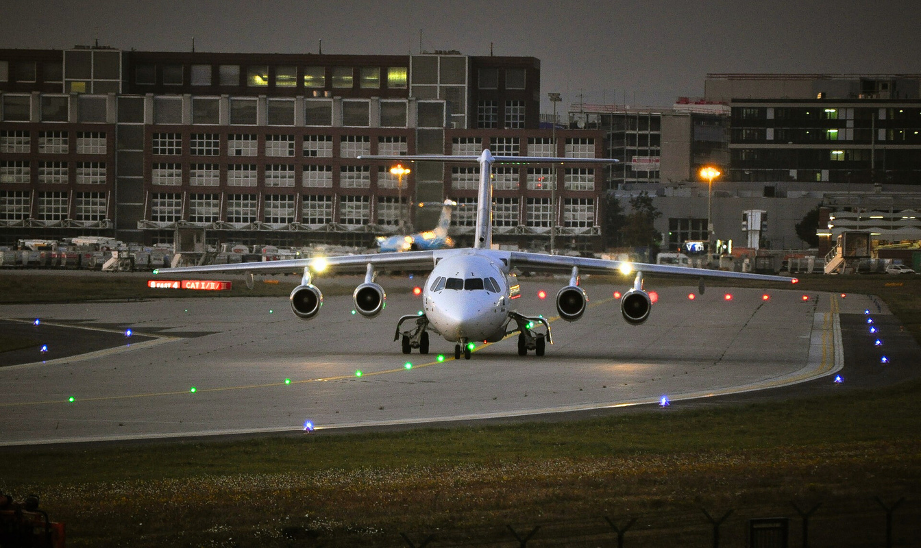
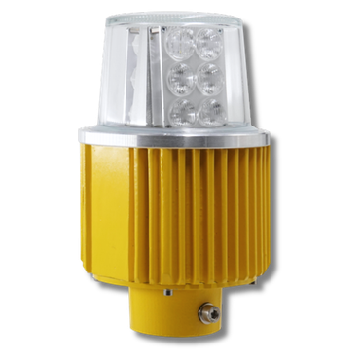

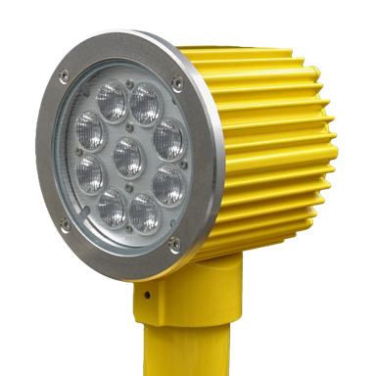
LED lights
Elevated LED lights
TLE22 (AIRPORTS)
6,6 A/2,2 A LED directional high intensity lights for CAT I-III
  RWY
TLE21 (AIRPORTS)
6,6 A/2,2 A LED directional high intensity lights for CAT I-III
  APP, ASR, END, THRWB

Slide 10
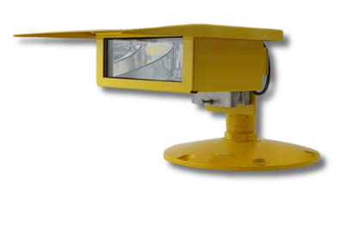
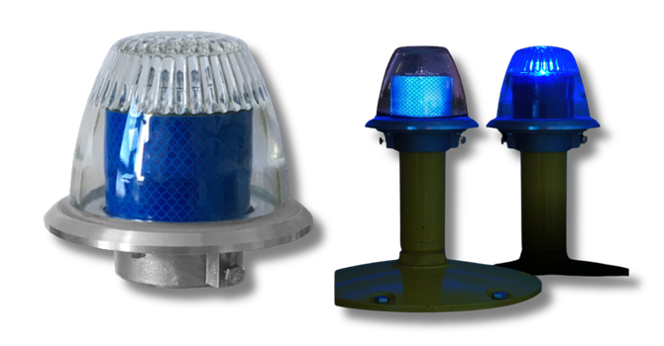
LED lights
Elevated LED lights
THF-25 (AIRPORTS/HELIPORTS)
230 V LED surface floodlight for helipads and airport areas providing glare-free, uniform surface lighting for landing and loading activities
TLE23 (AIRPORTS/HELIPORTS)
6,6 A/2,2 A LED omnidirectional lights with reflection and active lighting
  TWY

Slide 11
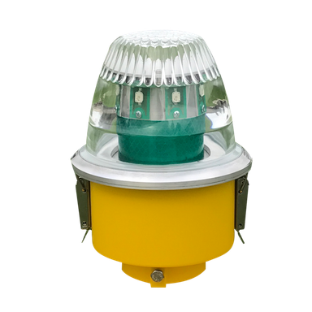
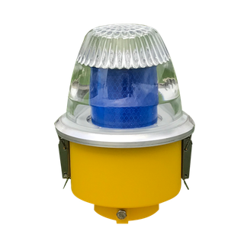
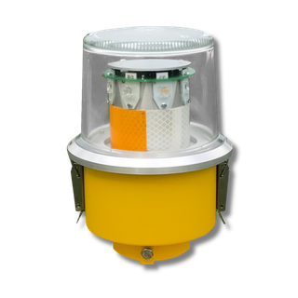
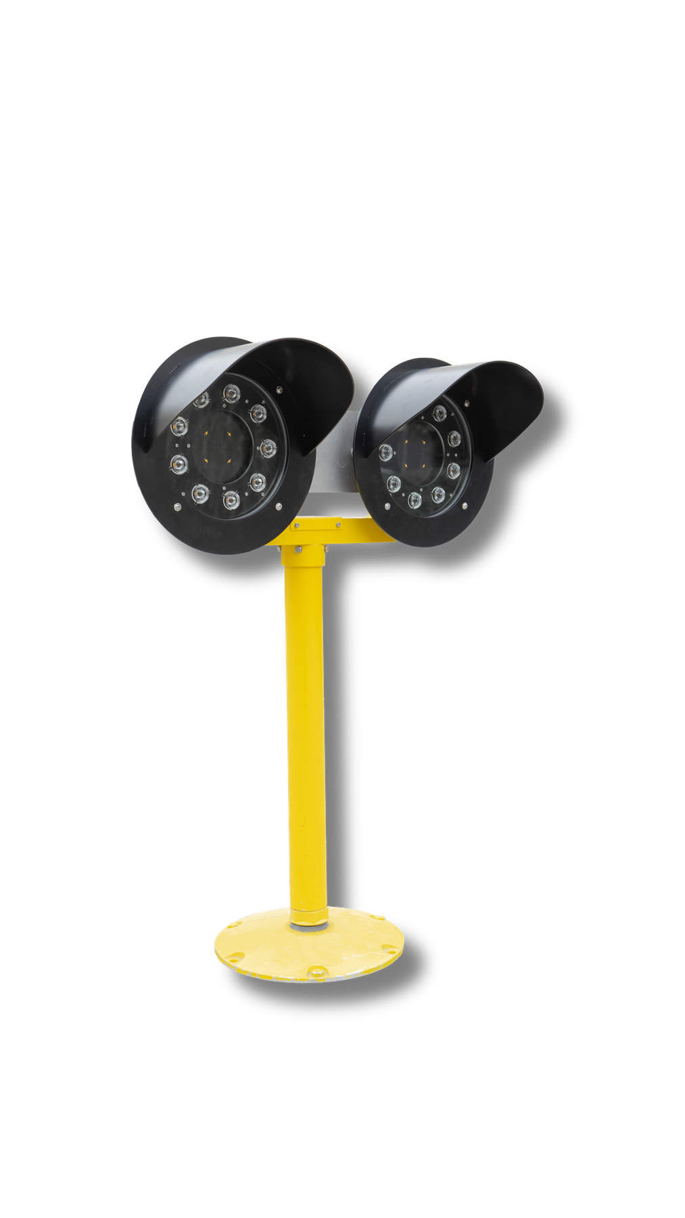
LED lights
Elevated LED lights
TLE20 (AIRPORTS/HELIPORTS)
6,6 A/2,2 A/230 V LED omnidirectional/directional
low/medium intensity lights for stationary/portable use
  APP, END, FATO, HAPP, RWY, THR, THREND, TLOF, TWY
TLE27 (AIRPORTS)
6,6 A/2,2 A LED directional high intensity
lights for CAT I-III
  RGL

Slide 12
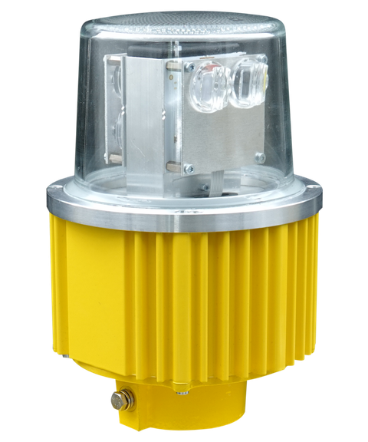
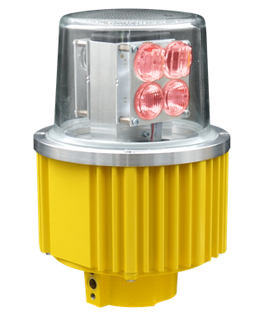
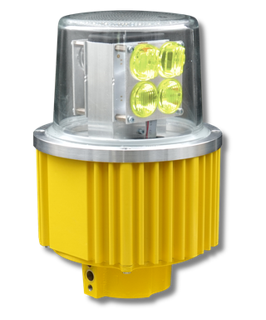
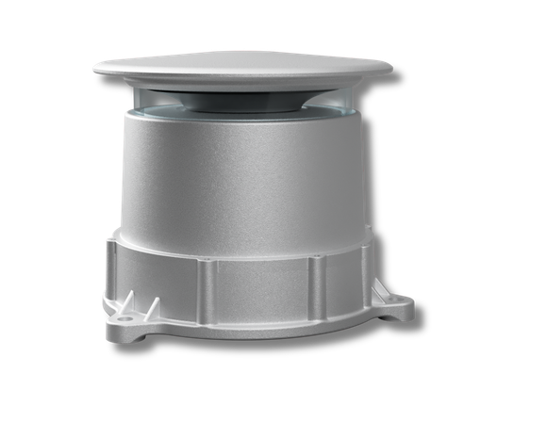
LED lights
Elevated LED lights
TLE24 (AIRPORTS)
6,6 A/2,2 A LED directional low/medium intensity lights for CAT I-III
  APP, END, RWY, THR, THREND
TLB1-H.LE (HELIPORTS)
230 V LED omnidirectional heliport beacon

Slide 13
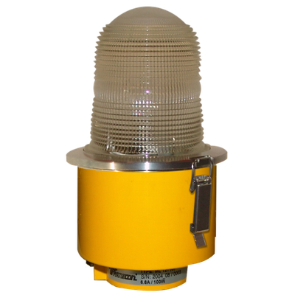
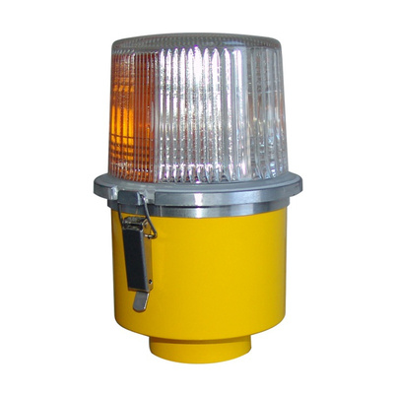
Halogen lights
Elevated lights
ML 121 (AIRPORTS/HELIPORTS)
halogen 6,6 A elevated omnidirectional low/medium intensity lights
  APP, END, THR, TWY, FATO, TLOF, HAPP
ML 122 (AIRPORTS)
halogen 6,6 A elevated omnidirectional/directional medium intensity lights
  APP, END, THR, THREND, RWY, TWY

Slide 14
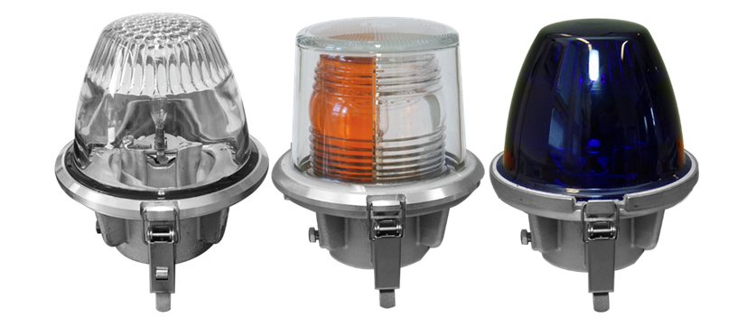
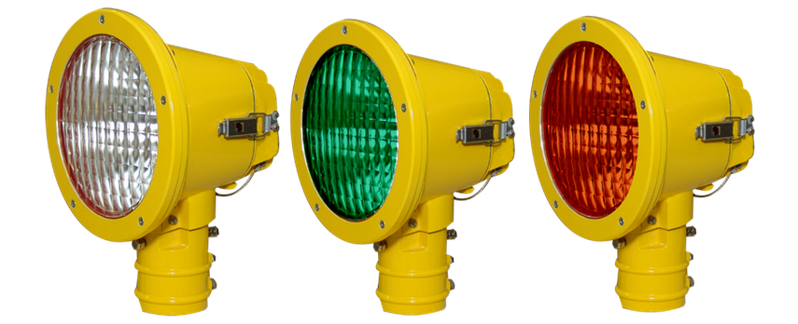
Halogen lights
Elevated lights
TL 322 (AIRPORTS)
6,6 A halogen omnidirectional/directional lights high/medium/low intensity
  CAT I-III – RWY
  NO-CAT – APP, END, RWY, THR, THREND, TWY
TL 421 (AIRPORTS)
6,6 A halogen unidirectional high intensity lights for CAT I-III
  APP, ASR, END, THR, THRWB

Slide 15
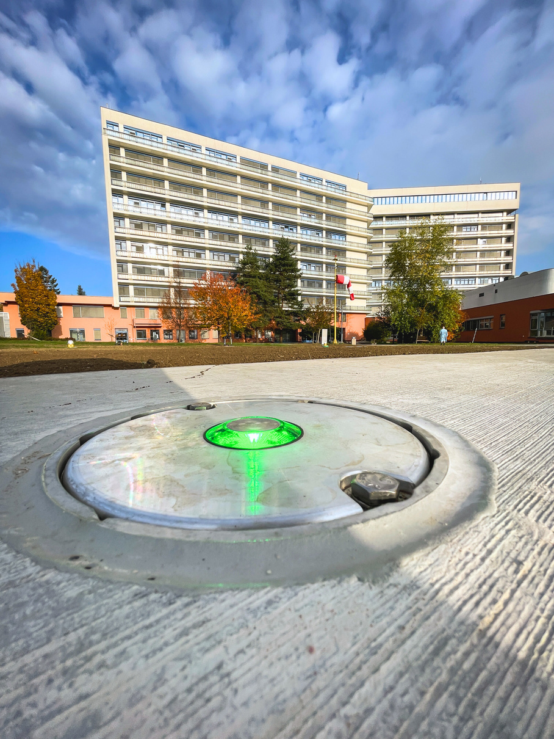
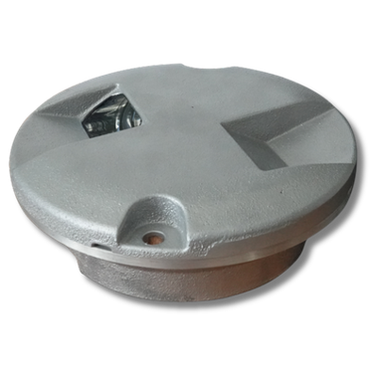
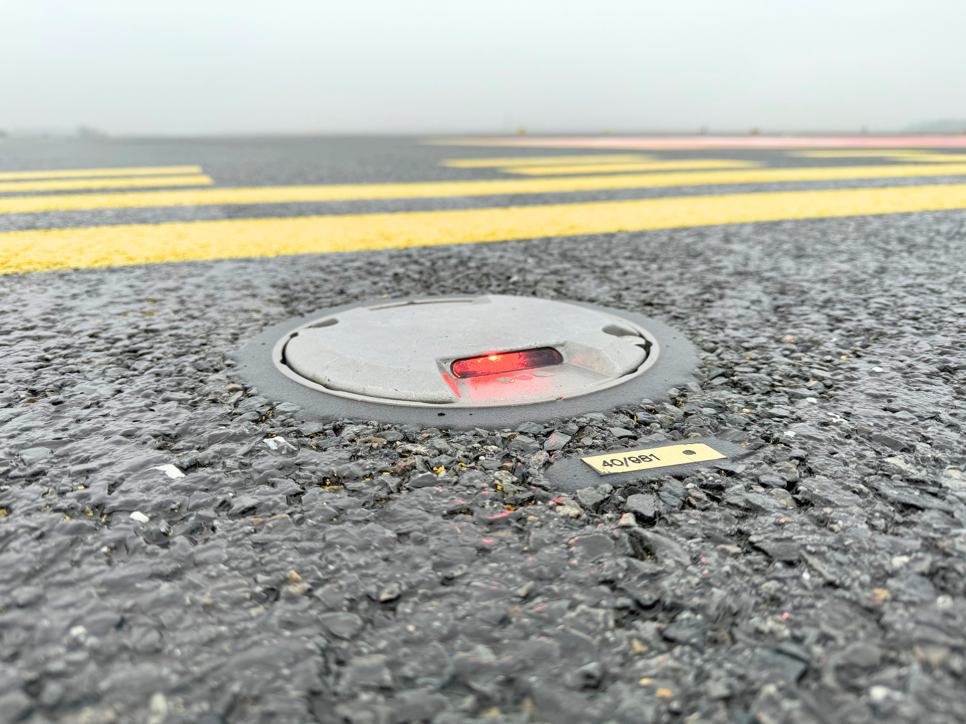
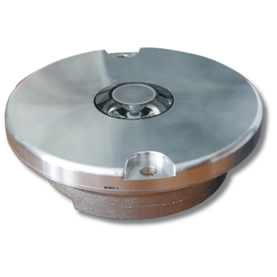
Inset lights
INSET LIGHTS
(TI-HALOGEN/TLI-LED)
TI42/TLI42 (AIRPORT/HELIPORTS)
6,6 A/230 V halogen/LED omnidirectional
low/medium intensity lights
  8" diameter, 3,5 mm protrusion
  FATO, FPAG, RWY, SBL, SMG, TCL, TLOF, TWY
TI40/TI41 (AIRPORT)
6,6 A halogen directional high intensity lights for CAT I-III
  40 series - 8" diameter, 9,35 mm protrusion
  41 series - 8" diameter, 6,35 mm protrusion
  RCL, RETIL, TDZ, THL

Slide 16
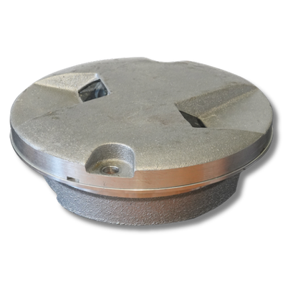
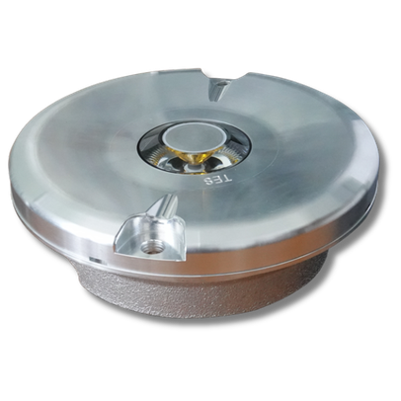
Inset lights
INSET LIGHTS
(TI-HALOGEN/TLI-LED)
Tl44 (AIRPORTS)
44 series - 8" diameter, 6,35 mm protrusion
6,6/2,2 A halogen directional lights CAT I-III
  EREX, REL, RGL, SBL, TCL
NO-CAT (low/medium intensity)
  END - runway end lights
  THR - threshold lights
  THREND - threshold and runway end lights
TI43/TLI43 (AIRPORTS/HELIPORTS)
6,6 A/230 V halogen/LED omnidirectional low/medium intensity lights
  8" diameter, 4,0 mm protrusion
  FPAG, SMG, TLOF

Slide 17
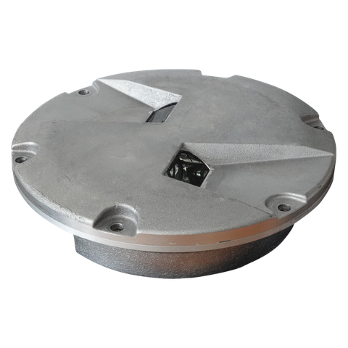
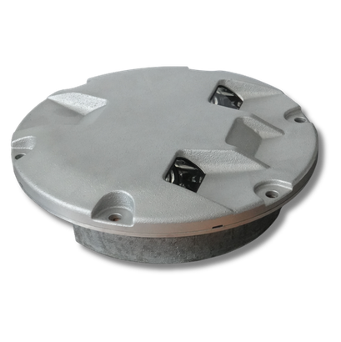
Inset lights
INSET LIGHTS
(TI-HALOGEN/TLI-LED)
TI45 (AIRPORTS)
6,6/2,2 A halogen directional lights
for CAT I-III
  8" diameter, 6,35 mm protrusion
  SBL, TCL
TI70 (AIRPORTS)
6,6 A halogen directional lights
for CAT I-III
  12" diameter, 12,5 mm protrusion
  APP, END, RWY, RGL, THR, THREND

Slide 18
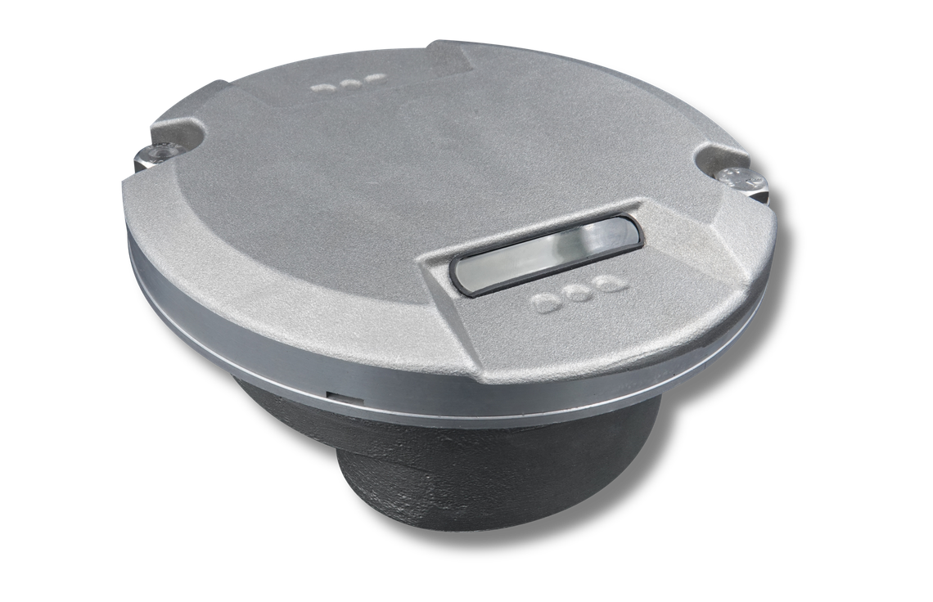
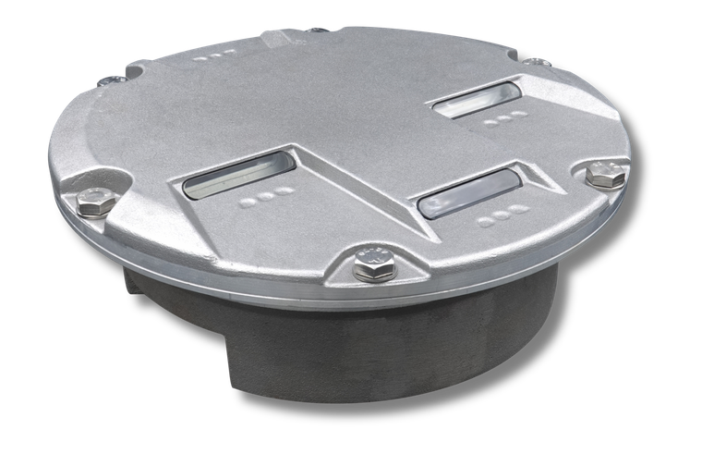
Inset lights
INSET LIGHTS
(TI-HALOGEN/TLI-LED)
TLl50 (AIRPORTS)
8" diameter, 6,35 mm protrusion, 6,6 A/2,2 A
LED directional lights
  EREX, RCL, REL, RETIL, RGL, SBL, TCL, TDZ, THL
TLl80 (AIRPORTS)
12" diameter, 6,35 mm protrusion, 6,6 A/2,2 A LED directional lights for CAT I-III
  APP, ASR, END, THR, THRWB

Slide 19


Inset lights
INSET LIGHTS
(TI-HALOGEN/TLI-LED)
TLl81 (AIRPORTS)
12" diameter, 6,35 mm protrusion, 6,6 A/2,2 A LED directional lights for CAT I-III
  RWY , RGL

Slide 20



Airport signs
  TZP-E - 6,6 A halogen internally illuminated airport signs
  TZP-D - 6,6 A LED internally illuminated airport signs
  TZP-ED - “retrofit” kits for modification of existing halogen signs to LED signs
  TZP-R - reflective airport signs
  all types of signs may be produced as mandatory instruction or information signs with legend
  height 200/300/400 mm

Slide 21


AMS
(ALCMS)
MAX
MINI
MICRO GP
TWS
KS-AMS
SU-24B.LMS
STANDARD

Slide 22

AMS
(ALCMS)
Monitoring and control
  airfield ground lighting systems (AGL)
  constant current regulators (CCR)
  radio navigation systems and airport equipment (RNAV)
  energy power systems (EPS)
  meteorological systems (ME)
  protection zones, control and monitoring of distant objects
  receiving, sending and processing data from the aviation fixed telecomunication network (AFTN), the necessary requisite is the provision of appropriate input
  archiving of operational and fault conditions
  available in several sizes, depending on the customer's needs
TWS
KS-AMS
SU-24B.LMS

Slide 23

Power
equipment
Regulators TCR.2 (CCR)
  constant current regulator (power supply) of serial circuits for airport and heliport lighting
  thyristor-controlled, air-cooled transformer 4-30 kVA
  6,6 A or 8,3 A output current system (user-selectable)
  regulation in 3/5/7 intensity steps
  over-current and over-voltage protection
  digital data entry and display
  remote and local control
  all control and monitoring elements on front panel
  all connectors accessible from the front side

Slide 24

Power
equipment
TRS 10
  automatic switchboard power supply source
  available for 250 A, 400 A and 630 A total output load
  automatic switch-over between 2 mains supply sources and 1 or 2 diesel generator set(s)
  can be equipped with various combinations of one/two/three-phase outputs
  all control and monitoring elements on front panels
  all connectors accessible from the front side
  equipped with PLC touch-screen display
  automatic and manual operation
  possible remote monitoring by AMS

Slide 25

Power
equipment
TRP.1.X
  power supply (230 V) for parallel lighting
  suitable for small airports and heliports
  total max. load 1×32 A or 3×16 A
  all control and monitoring elements on front panel
  all connectors accessible from the front side
RDG
  automatic switchboard for airports and heliports
  suitable for small airports and heliports
  total max. current load 3×63 A
  automatic switch-over between 1 mains supply source and 1 diesel generator
RDG+TRP
  combination of RDG and TRP.1.X in one cabinet

Slide 26


LMS (ILCMS)
SYSTEM
  provides remote control and monitoring of individual lights
  used for stop bars, taxiway centre lines, RETILs, CAT II/III airport signs etc.
AIRPORT TRAFFIC CONTROL
SUBSTATION
AIRFIELD
LMC
LLC
LCU
TWS
KS-AMS
SU-24B.LMS
AMS
CCR
AGL

Slide 27

Heliports
TURN-KEY HELIPORTS
We offer turnkey solutions for heliports with all necessary hardware and software, including the supply of modular units.
Transport
  all modules are transported as standard ISO 6 m containers
  transport by sea, air, road or rail
Dimensions and technical parameters
  normalized ISO containers 20 feet (6 m) long
  special welded structure resistant to corrosion
  wide range of working temperatures
Power supply type
  parallel power supply - simple and low-cost, suitable for small heliports
  serial power supply - system 6,6 A, suitable for all types and sizes of heliports

Slide 28
Heliports
MOBILE HELIPORT TRAILERS
  complete mobile heliport on transportable trailer
  all equipment installed on/in weatherproof module
  module with equipment removeable with forklift
  trailer attachable to cars with standard tow hitch
  single trailer reusable with many modules
  all lights are stored on roll-out shelves
  parallel power supply from generator set
  stationary power supply not required
  all accessories and cables included

Slide 29







Contact Us
Phone :
Email :
+420 602 531 928
info@transcon.cz
Address :
Social Media
Kvapilova 2133, Frydek-Mistek
738 01, Czech Republic
linkedin.com

